Slide 1
An Update of Operators Requirements on Network Management Protocols and Modelling draft-ietf-nmop-rfc3535-20years-later
Mohamed Boucadair (Orange), Luis M. Contreras (Telefónica), Óscar Gonzalez de Dios (Telefónica), Thomas Graf (Swisscom), Reshad Rahman (Equinix)
IETF 125, NMOP WG, Shenzhen, March 2026

Slide 2
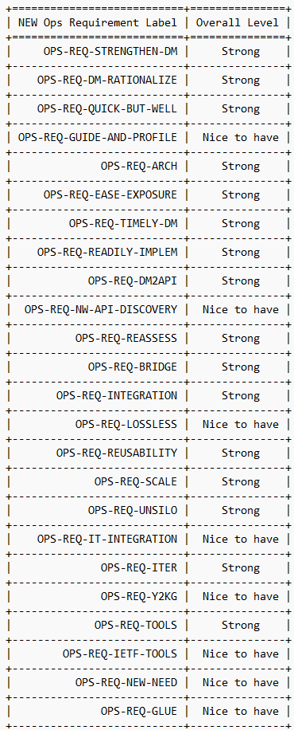
Status
Overall Requirements Levels: Operators View
List of updated operators’ requirements is stable
Operators’ prioritization of that list (strong, nice-to-have) is stable as well
These requirements need to be balanced to also take into account other views (vendors, etc.): collaborative requirements (In progress)
Build a very few set of actionable items that will be the focus of work in the IETF
Actionable by the IETF as a whole, including WGs, ADs, etc. Not specifically, NMOP
2

Slide 3

Status vs. Expected Charter Item
List of updated operators’ requirements is stable
Operators’ prioritization of that list (strong, nice-to-have) is stable as well
These requirements need to be balanced to also take into account other views (vendors, etc.): collaborative requirements (In progress)
Build a very few set of actionable items that will be the focus of work in the IETF
Actionable by the IETF as a whole, including WGs, ADs, etc. Not specifically, NMOP
3

Slide 4
Discuss Item# 1
List of updated operators’ requirements is stable
Operators’ prioritization of that list (strong, nice-to-have) is stable as well
These requirements need to be balanced to also take into account other views (vendors, etc.): collaborative requirements (In progress)
Build a very few set of actionable items that will be the focus of work in the IETF
Actionable by the IETF as a whole, including WGs, ADs, etc. Not specifically, NMOP
Should we keep this part of the document?
Are there objections to keep it in the document?
4

Slide 5
Consolidated List
Put more focus on service and network data models while ensuring that the realization of these abstractions can be easily correlated with underlying functionalities (OPS-REQ-STRENGTHEN-DM, OPS-REQ-INTEGRATION)
Progress much faster (OPS-REQ-QUICK-BUT-WELL, OPS-REQ-TIMELY-DM)
Implement minimal functionality, not bells and whistles (OPS-REQ-ITERATE)
Have running code while a specification is under development (OPS-REQ-READILY-IMPLEM, OPS-REQ-TOOLS)
Have vendors and operators on board at the time of developing the solution
Provide independent compliance suites to validate features (OPS-REQ-GUIDE-AND-PROFILE)
Need for means to correlate data learned from different means (OPS-REQ-REUSABILITY)
Investigate approaches to ease adoption and integration into an operator’s environments (OPS-REQ-EASE-EXPOSURE, OPS-REQ-DM2API, OPS-REQ-INTEGRATION)
Network-centric approaches have limits, need to better integrate and learn from techniques in other domains (OPS-REQ-BRIDGE)

Slide 6
Consolidated List
ONSEN
Put more focus on service and network data models while ensuring that the realization of these abstractions can be easily correlated with underlying functionalities (OPS-REQ-STRENGTHEN-DM, OPS-REQ-INTEGRATION)
Progress much faster (OPS-REQ-QUICK-BUT-WELL, OPS-REQ-TIMELY-DM)
Implement minimal functionality, not bells and whistles (OPS-REQ-ITERATE)
Have running code while a specification is under development (OPS-REQ-READILY-IMPLEM, OPS-REQ-TOOLS)
Have vendors and operators on board at the time of developing the solution
Provide independent compliance suites to validate features (OPS-REQ-GUIDE-AND-PROFILE)
Need for means to correlate data learned from different means (OPS-REQ-REUSABILITY)
Investigate approaches to ease adoption and integration into an operator’s environments (OPS-REQ-EASE-EXPOSURE, OPS-REQ-DM2API, OPS-REQ-INTEGRATION)
Network-centric approaches have limits, need to better integrate and learn from techniques in other domains (OPS-REQ-BRIDGE)
VELOCE
e.g., YP-Lite
Implementation policy in OPS WG Charters
ONSEN
KG, Data Mesh, AINETOPS

Slide 7
Open Discussion (depends #1)
Q#2: Should the consolidated list be further trimmed?
Q#3: Should the list be ordered?
Q#4: Is there any missing important recommendations?

